Slide 1

Hacking Web Servers
Volume 3, Module 3, v12, with v13 updates at the end

Slide 2
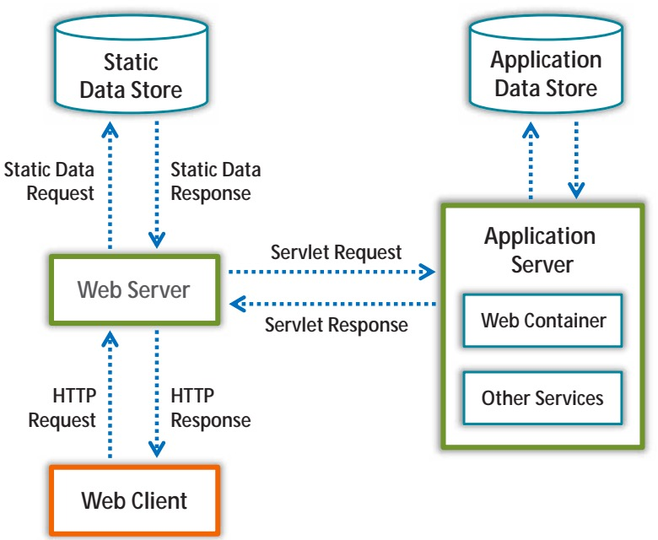
Web Server Components
Ethical Hacking and Countermeasures Copyright © by EC-Council. All Rights Reserved. Reproduction is Strictly Prohibited.
Notes:
Document Root
Server Root
Virtual Document Tree
Virtual Hosting
Web Proxy
Open-source Web Server Architecture – LAMP: Linux, Apache, MySQL, PHP
IIS Web Server Architecture

Slide 3
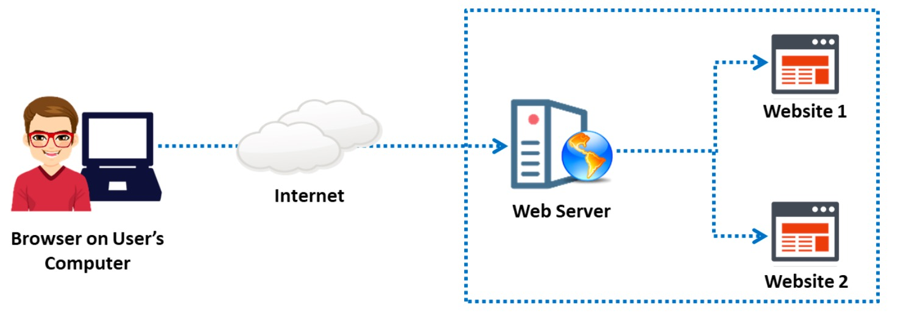
Web Server Security Issues
Ethical Hacking and Countermeasures Copyright © by EC-Council. All Rights Reserved. Reproduction is Strictly Prohibited.
Notes:
A web server is a hardware/software application that hosts websites and makes them accessible over the Internet. A web server, along with a browser, successfully implements client–server model architecture. In this model, the web server plays the role of the server, and the browser acts as the client. To host websites, a web server stores the web pages of websites and delivers a particular web page upon request. Each web server has a domain name and an IP address associated with that domain name. A web server can host more than one website. Any computer can act as a web server if it has specific server software (a web server program) installed and is connected to the Internet.

Slide 4
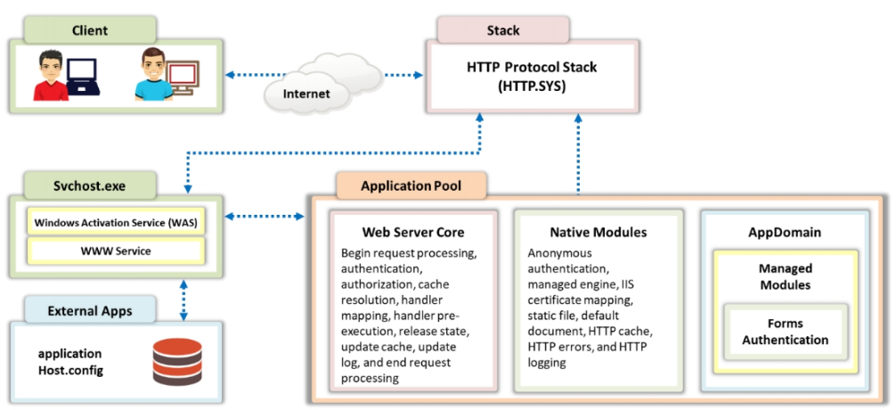
IIS Web Server Architecture
Ethical Hacking and Countermeasures Copyright © by EC-Council. All Rights Reserved. Reproduction is Strictly Prohibited.
Notes:
The Internet Information Service (IIS) is a web server application developed by Microsoft for Windows. IIS for Windows Server is a flexible, secure, and easy-to-manage web server for hosting anything on the web. It supports HTTP, HTTP Secure (HTTPS), File Transfer Protocol (FTP), FTP Secure (FTPS), Simple Mail Transfer Protocol (SMTP), and Network News Transfer Protocol (NNTP

Slide 5
Web Server Attack Goals
Stealing CC info or other sensitive credentials
Incorporating the server into a botnet
DB compromise
Hiding/redirecting traffic
Stealing closed source software
Privilege escalation
Curiosity
Damaging the reputation of the target
Notes:
Web server attacks are carried out with various goals in mind, aiming to exploit vulnerabilities and weaknesses in web servers to gain unauthorized access, steal sensitive information, disrupt services, or cause damage to the targeted system. Here are some common goals of web server attacks:

Slide 6
Web Server Attack Impact
User account compromise
Website defacement
Secondary attacks from the website
Root access to server or other applications
Data tampering
Data Theft
Damage to company reputation
Notes:
Downtime: Many attacks, such as Denial of Service (DoS) and Distributed Denial of Service (DDoS), can lead to server overloading, causing it to become unresponsive or crash. This results in website downtime, disrupting services and inconveniencing users.
Data Breach: If the attack is successful in bypassing security controls, sensitive data stored on the server may be exposed or stolen. This could include personal information, financial data, user credentials, and confidential business information.
Loss of Revenue: Website downtime or a compromised server can lead to a loss of revenue for e-commerce businesses that rely on their online presence to conduct transactions.
Reputation Damage: A successful attack can severely damage the reputation of the organization or website, leading to a loss of trust from customers, partners, and stakeholders.
Defacement: Web server attacks that result in defacement can tarnish a website's image and credibility. Visitors may be deterred from using the site due to its altered content.
Malware Distribution: If attackers use the web server to distribute malware to visitors' devices, it can lead to the spread of viruses, ransomware, or other malicious software, causing harm to users.
Legal and Regulatory Consequences: Depending on the nature of the attack and the data involved, organizations may face legal consequences, especially if they are found to be non-compliant with data protection regulations.
Financial Loss: Recovering from a successful attack can be costly. Organizations may need to invest in forensic investigations, security improvements, data recovery, and legal assistance.
Disruption of Services: In the case of botnet recruitment, the compromised server may be used to participate in other attacks, leading to further disruption of services on the internet.
Loss of Intellectual Property: Attacks targeted at stealing intellectual property can result in valuable proprietary information being stolen or leaked, affecting a company's competitive edge.

Slide 7

Web Server Attacks
DoS/DDos
DNS Server Hijacking
DNS Amplification
Directory Traversal
MITM/Sniffing
Phishing
Website Defacement
Web Server Misconfiguration
Notes:
DoS/DDoS (Denial of Service/Distributed Denial of Service):
Denial of Service (DoS) refers to an attack where a single source attempts to overwhelm a target (e.g., a web server) with an excessive amount of traffic or requests, causing it to become unavailable to legitimate users.
Distributed Denial of Service (DDoS) is a variant of DoS that involves multiple sources (often a botnet) coordinating to flood the target with traffic simultaneously, making it even harder to defend against.
DNS Server Hijacking:
DNS Server Hijacking involves attackers gaining unauthorized access to a DNS server or altering its settings to redirect domain names to malicious IP addresses. This can lead to users being redirected to fake websites, enabling various attacks like phishing.
DNS Amplification:
DNS Amplification is a type of DDoS attack that abuses the behavior of open DNS resolvers. Attackers send small requests with the victim's IP address as the source to these resolvers, which then respond with much larger responses, amplifying the attack traffic and overwhelming the target.
Directory Traversal:
Directory Traversal (also known as Path Traversal) is a vulnerability that allows attackers to access files or directories outside of the web server's intended directory structure. This can lead to unauthorized access to sensitive files, including configuration files or user data.
MITM/Sniffing (Man-in-the-Middle/Sniffing):
Man-in-the-Middle (MITM) refers to an attack where an attacker intercepts and relays communication between two parties without their knowledge. This allows the attacker to eavesdrop on sensitive data or modify the communication.
Sniffing is the act of intercepting and monitoring network traffic to capture data, such as login credentials or sensitive information, in plain text.
Phishing:
Phishing is a social engineering attack where attackers attempt to deceive users into revealing sensitive information, such as login credentials or financial details. This is usually done through fraudulent emails, websites, or messages that impersonate legitimate entities.
Website Defacement:
Website Defacement involves attackers altering the visual appearance or content of a website without permission. This can be done to spread a message, embarrass the website owner, or promote a cause.
Web Server Misconfiguration:
Web Server Misconfiguration refers to unintentional errors or oversights in configuring a web server's settings, leaving it vulnerable to exploitation. These misconfigurations can lead to unauthorized access, data leaks, or other security issues.

Slide 8

Web Server Attacks (Cont’d)
HTTP Response-Splitting
Web Cache Poisoning
SSH Brute Force
Web Server Password Cracking
Server-Side Request Forgery (SSRF)
Web Application Attacks
Notes:
HTTP Response-Splitting is a web application vulnerability that allows attackers to manipulate the content of an HTTP response. By inserting specific characters into user-provided input, attackers can split the response into multiple parts, potentially leading to various security issues, such as injecting malicious content or bypassing security mechanisms.
Web Cache Poisoning:Web Cache Poisoning is an attack that involves manipulating the cached content in a web server's cache or an intermediary cache (e.g., a CDN). Attackers insert malicious data into the cache, causing subsequent users to receive the manipulated content, which may lead to unauthorized access, data leaks, or other security breaches.
SSH Brute Force:SSH Brute Force is an attack where attackers attempt to gain unauthorized access to a system by systematically trying different combinations of usernames and passwords. They use automated tools to conduct repeated login attempts until they find valid credentials, potentially leading to unauthorized access or a compromised system.
Web Server Password Cracking:Web Server Password Cracking involves attempting to crack passwords used to access web servers, either through brute-force attacks (trying all possible combinations) or using dictionaries of commonly used passwords. Successful password cracking can lead to unauthorized access and control over the server.
Server-Side Request Forgery (SSRF):Server-Side Request Forgery (SSRF) is a web application vulnerability where an attacker can manipulate the server into making requests to internal or external resources on behalf of the application. This can lead to unauthorized data access, potential information disclosure, or attacks against internal systems.
Web Application Attacks:Web Application Attacks refer to a wide range of attacks specifically targeting vulnerabilities in web applications. These can include various attack types, such as SQL injection, Cross-Site Scripting (XSS), Cross-Site Request Forgery (CSRF), and more. The aim is to exploit weaknesses in the application code or design to compromise data or gain unauthorized access.

Slide 9

Web Server Attack Methodology
Information Gathering (ex: Whois, centralops.net)
Web Server Footprinting/Banner Grabbing (ex: Netcraft, Netcat, httprecon)
Website Mirroring (ex: NCollector Studio, HTTrack)
Vulnerability Scanning (ex: Netsparker, Fortify WebInspect)
Session Hijacking (ex: Burp Suite, Ettercap)
Web Server Passwords Hacking (ex: Hashcat, Ncrack, Rainbow crack )
Notes:
It is essential to understand these techniques for both defensive and offensive purposes in the field of cybersecurity. Ethical hackers and security professionals use some of these tools to identify vulnerabilities and strengthen security measures, while malicious actors may exploit these techniques to launch cyberattacks. Organizations must be proactive in securing their web servers and applications to protect against potential threats.

Slide 10
Web Server Attack Countermeasures*
Patch and update the server regularly
Update on an “as-needed” basis
Test service packs and hotfixes prior to deployment in production
Service packs, hotfixes, and security patch levels should be consistent on all domain controllers (DCs)
Backup tapes and repair disks should be created
Never trail by more than two service packs
Disable all unused script extension mappings
Avoid using default configurations
Notes:
Regular Software Updates:
Keep web server software, applications, and all associated components up to date with the latest security patches. Regularly check for updates and apply them promptly to address known vulnerabilities.
Web Application Firewalls (WAF):
Implement a Web Application Firewall (WAF) to filter and monitor incoming HTTP/HTTPS traffic. A WAF can help block malicious requests, SQL injections, XSS attacks, and other web application threats.
Secure Configuration:
Properly configure the web server and associated services to follow security best practices. Disable unnecessary features and services that might introduce potential risks.
Use HTTPS:
Implement HTTPS (SSL/TLS) encryption for secure communication between the web server and clients. This helps protect sensitive data in transit and prevents man-in-the-middle attacks.
Access Control and Authentication:
Enforce strong access controls and use multi-factor authentication (MFA) for administrative access. Limit access rights to only necessary personnel and ensure strong password policies.
Rate Limiting and IP Whitelisting:
Implement rate limiting to prevent brute-force attacks and use IP whitelisting to restrict access to the web server to trusted IP addresses only.
Intrusion Detection/Prevention Systems (IDS/IPS):
Utilize Intrusion Detection and Prevention Systems to monitor and respond to suspicious activities in real-time. These systems can help identify and block attacks as they happen.
Security Audits and Penetration Testing:
Conduct regular security audits and penetration tests to identify vulnerabilities and weaknesses in the web server and web applications. This allows for timely remediation of potential risks.
Secure Coding Practices:
Train developers in secure coding practices to build robust and secure web applications. This helps minimize the chances of introducing security flaws during the development process.
Security Monitoring and Logging:
Enable detailed logging and monitoring on the web server to track and analyze potential security incidents. This aids in identifying unusual activities and responding to attacks effectively.
DDoS Mitigation Services:
Consider using DDoS mitigation services or appliances to help protect against large-scale Distributed Denial of Service (DDoS) attacks.
Incident Response Plan:
Have a well-defined incident response plan in place to quickly respond to security incidents, mitigate their impact, and recover from attacks effectively.
Implementing these countermeasures collectively strengthens the overall security posture of the web server and reduces the risk of successful attacks. Regularly reassessing security measures and staying informed about emerging threats are also crucial aspects of maintaining web server security.

Slide 11
Web Server Attack Countermeasures (Cont’d)
Block
block all unnecessary ports, ICMP, and unnecessary protocols such as NetBIOS and SMB
Harden
harden the TCP/IP stack
Use
use TLS/SSL for web server communication
Disable
disable unused default user accounts
Eliminate
eliminate unnecessary database users and stored procedures
Follow
follow the principle of least privilege
Implement
implement strong password policies, audits and alerts for login failures
Monitor and check
monitor and check all network services logs, website access logs, database server logs, and OS logs frequently
Avoid
avoid all non-web file types from being referenced in a URL
Refer
*refer to additional countermeasures in the reading

Slide 12
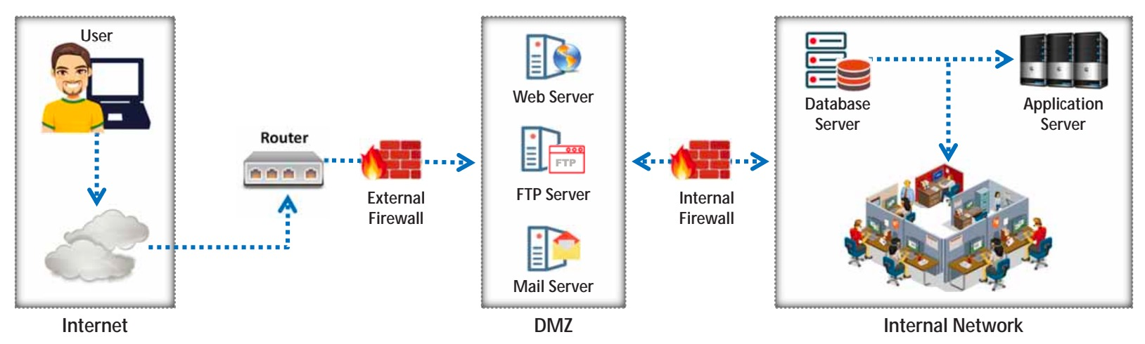
Securing Web Servers
Ethical Hacking and Countermeasures Copyright © by EC-Council. All Rights Reserved. Reproduction is Strictly Prohibited.
Notes:
An ideal web hosting network should be designed with three segments: an Internet segment; a secure server security segment, which is often called the demilitarized zone (DMZ); and an internal network. The first step in securing web servers is to place them separately in the DMZ, which is isolated from the public network and from the internal web-hosting network.
In a segmented network, an attacker who compromises one segment of the network will not be able to compromise the security of other segments of the network

Slide 13
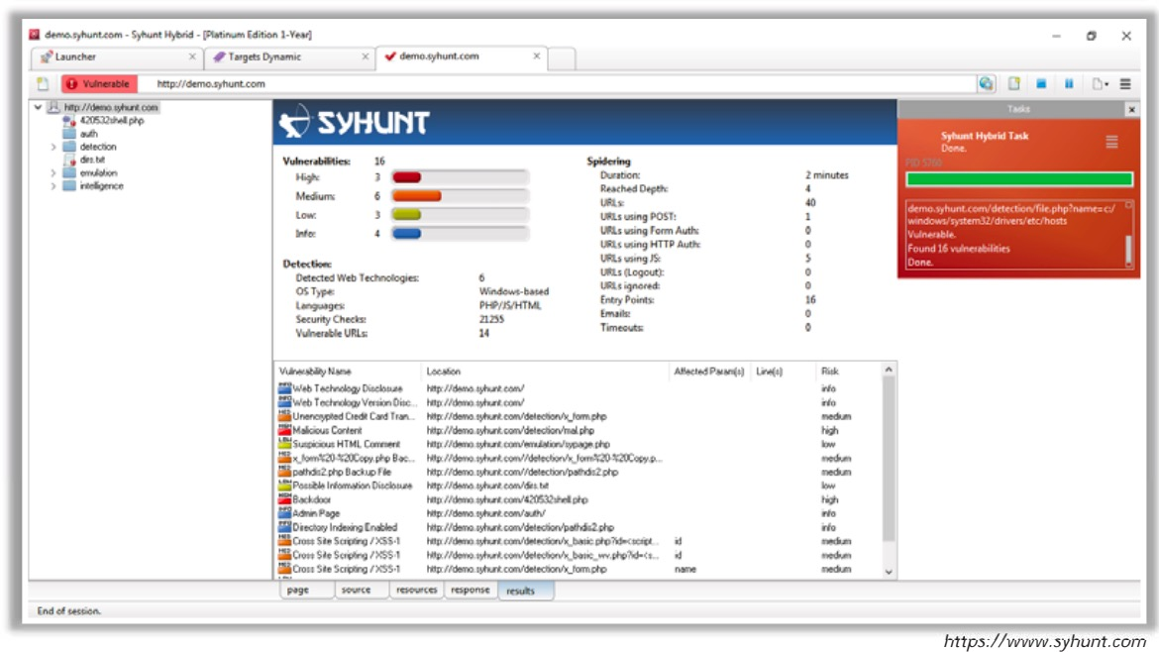
Web Application Security Tools
Ethical Hacking and Countermeasures Copyright © by EC-Council. All Rights Reserved. Reproduction is Strictly Prohibited.
Notes:
The Syhunt Hybrid scanner automates web application security testing and guards the organization’s web infrastructure against web application security threats. Syhunt Dynamic crawls websites and detects XSS, directory transversal problems,

Slide 14
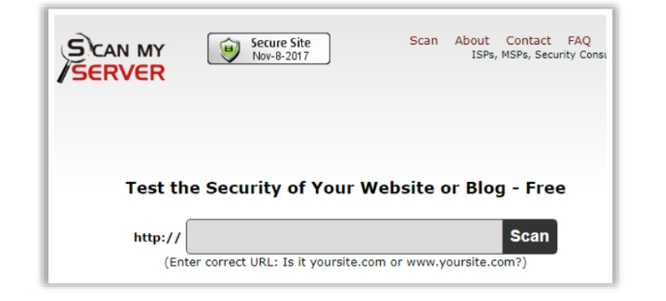
Web Security Tools
Ethical Hacking and Countermeasures Copyright © by EC-Council. All Rights Reserved. Reproduction is Strictly Prohibited.
Notes:
ScanMyServer is used to find security vulnerabilities in a website or web server. It can generate comprehensive test reports and assist in fixing security problems that might exist in a company’s website or web server.

Slide 15
CEHv13 Update – Advanced Web Server Exploits
CEHv13 adds emphasis on:
  Server-side request forgery (SSRF) in cloud environments (e.g., AWS metadata abuse)
  HTTP/2 and API-based web servers with nontraditional vulnerabilities
  Chaining misconfigurations, outdated frameworks, and weak credentials for privilege escalation
Web server enumeration now includes detection of:
  Containerized workloads (Docker, Kubernetes)
  Serverless misconfigurations
Pen testers are trained to use automation tools like AI-enhanced Burp extensions and deep scan scripts

Slide 16
CEHv13 Update – Web Server Defense Enhancements
Web server security focus now includes:
  Runtime Application Self-Protection (RASP) integration
  Deployment of WAFs with AI anomaly detection (e.g., AWS WAF Bot Control)
  Shift from patching schedules to Continuous Threat Exposure Management (CTEM)
New CEHv13 guidance on:
  Mapping server risks to MITRE ATT&CK T1190 (Exploit Public-Facing App)
  Using cloud-native web server controls (e.g., Azure App Gateway, GCP Armor)
  Performing zero-trust validation of inbound and outbound traffic at the web tier

Slide 17
Hacking Web Applications
Volume 3, Module 4, v12, with v13 additions at the end

Slide 18
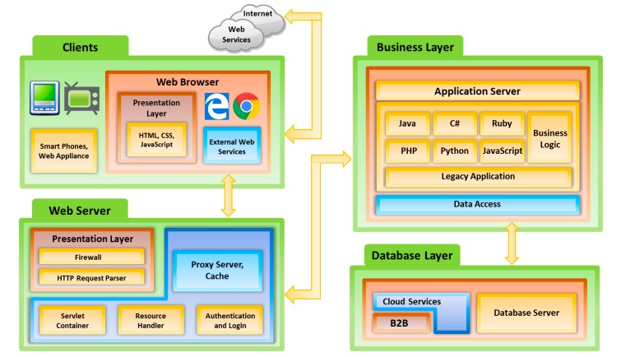
Web Applications Concepts
The main function of web application is fetching user-requests from a database
Ethical Hacking and Countermeasures Copyright © by EC-Council. All Rights Reserved. Reproduction is Strictly Prohibited.
Notes:
Web Application Architecture:
Client/Presentation layer
Business logic layer
Database layer

Slide 19
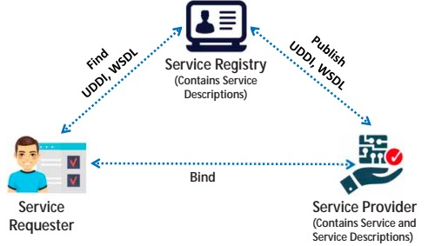
Web Service Architecture
Ethical Hacking and Countermeasures Copyright © by EC-Council. All Rights Reserved. Reproduction is Strictly Prohibited.
Notes:
Architecture:
Service Provider
Service Requester
Service Registry
Operations:
Publish
Find
Bind
Characteristics of Web Services ▪ XML-based: Web services use XML for data representation and transportation. XML usage can avoid OS, networking, or platform binding. Applications that provide web services are highly interoperable.
▪ Coarse-grained service: In web services, some objects contain a massive amount of information and offer greater functionality than fine-grained services. A coarse-grained service is a combination of multiple fine-grained services.
▪ Loosely coupled: Web services support a loosely coupled approach for interconnecting systems. The interaction between the systems can occur via the web API by sending XML messages. The web API incorporates a layer of abstraction for the infrastructure to make the connection flexible and adaptable.
▪ Asynchronous and synchronous support: Synchronous services are called by users who wait for a response, whereas asynchronous services are called by users who do not wait for a response. RPC-based messages and document-based messages are often used for synchronous and asynchronous web services.
Synchronous and asynchronous endpoints are implemented using servlets, SOAP/XML, and HTTP.
▪ RPC support: Web services support remote procedure calls (RPC) similarly to traditional applications.

Slide 20
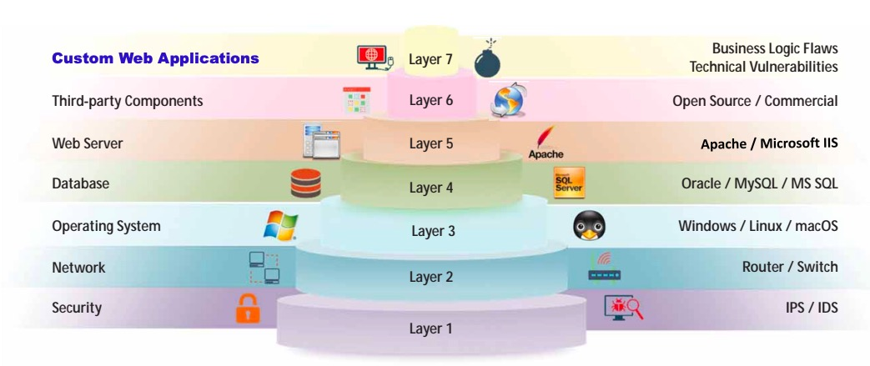
Vulnerability Stack
Ethical Hacking and Countermeasures Copyright © by EC-Council. All Rights Reserved. Reproduction is Strictly Prohibited.

Slide 21
Web Application Threats
Injection
(SQL; command – shell, file, HTML embedding; LDAP; Server-side JS; CRLF; HTML)
Broken Authentication
(Session ID shown in URL; Password Exploitation; Timeout Exploitation)
Security Misconfiguration
Unvalidated Input; Parameter/ Form Tampering; Improper Error Handling; Insufficient Transport Layer Protection
XML External Entity
(XXE)
Broken Access Control
(Insecure Direct Object references; Missing Function Level Access Control)
Cross-Site Scripting
(XSS)
Insecure Deserialization
Sensitive Data Exposure
Using Component with Known Vulnerabilities
Insufficient Logging and Monitoring
Notes:
Injection (SQL; command – shell, file, HTML embedding; LDAP; Server-side JS; CRLF; HTML)
Broken Authentication (Session ID shown in URL; Password Exploitation; Timeout Exploitation)
Sensitive Data Exposure
XML External Entity (XXE)
Broken access Control (Insecure Direct Object references; Missing Function Level Access Control)
Security Misconfiguration (Unvalidated Input; Parameter/Form Tampering; Improper Error Handling; Insufficient Transport Layer Protection)
Cross-Site Scripting (XSS)
Insecure Deserialization
Using Component with Known Vulnerabilities
Insufficient Logging and Monitoring

Slide 22
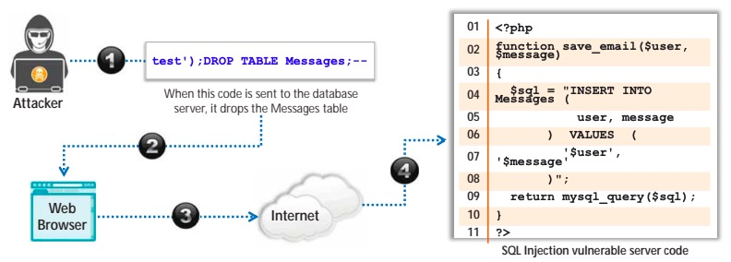
Web Application SQL Threats
Ethical Hacking and Countermeasures Copyright © by EC-Council. All Rights Reserved. Reproduction is Strictly Prohibited.
Notes:
Injection (SQL; command – shell, file, HTML embedding; LDAP; Server-side JS; CRLF; HTML)
Broken Authentication (Session ID shown in URL; Password Exploitation; Timeout Exploitation)
Sensitive Data Exposure
XML External Entity (XXE)
Broken access Control (Insecure Direct Object references; Missing Function Level Access Control)
Security Misconfiguration (Unvalidated Input; Parameter/Form Tampering; Improper Error Handling; Insufficient Transport Layer Protection)
Cross-Site Scripting (XSS)
Insecure Deserialization
Using Component with Known Vulnerabilities
Insufficient Logging and Monitoring

Slide 23

Other Web Application Threats
Directory Traversal
Unvalidated Redirects and Forwards
Watering Hole Attack
Cross-Site Request Forgery (CSRF) Attack
Cookie/Session Poisoning
Web Service Attack
Web Service XML Poisoning
Web Service Footprinting Attack
Hidden Field Manipulation Attack
Web-based Timing Attacks
MarioNetAttack
Clickjacking Attack
DNS Rebinding Attack

Slide 24
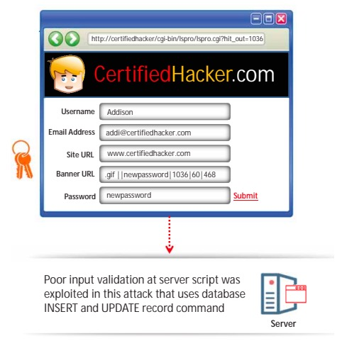
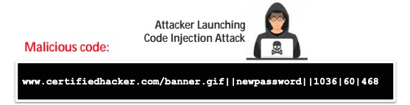
Command Injection Example
Ethical Hacking and Countermeasures Copyright © by EC-Council. All Rights Reserved. Reproduction is Strictly Prohibited.
Notes:
Attacker enters the following malicious code (account number) with a new password. www.certifiedhacker.com/banner.gif||newpassword||1036|60|468 The last two sets of numbers denote the banner size. Once the attacker clicks the submit button, the password for the account 1036 is changed to “newpassword." The server script assumes that only the URL of the banner image file is inserted into that field.

Slide 25
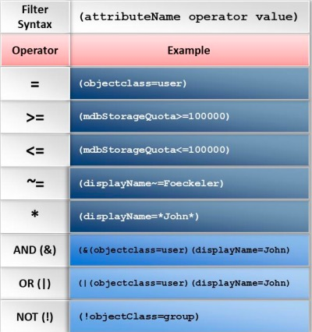
LDAP Injection Attack
Ethical Hacking and Countermeasures Copyright © by EC-Council. All Rights Reserved. Reproduction is Strictly Prohibited.
Notes:
An LDAP injection attack works in the same way as an SQL injection attack, but it exploits user parameters to generate an LDAP query. It runs on an Internet transport protocol such as TCP, and it is an open-standard protocol for manipulating and querying Directory Services.

Slide 26
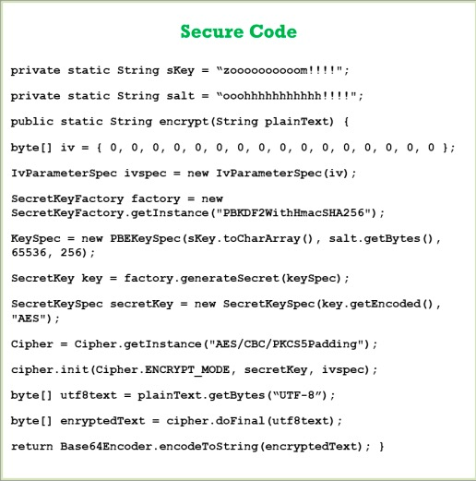
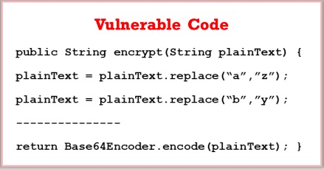
Sensitive Data Exposure
Sensitive Data Exposure
Ethical Hacking and Countermeasures Copyright © by EC-Council. All Rights Reserved. Reproduction is Strictly Prohibited.
Notes:
Many web applications do not protect their sensitive data properly from unauthorized users. Web applications use cryptographic algorithms to encrypt their data and other sensitive information that they need to transfer from the server to the client or vice versa. Sensitive data exposure occurs due to flaws such as insecure cryptographic storage and information leakage.

Slide 27
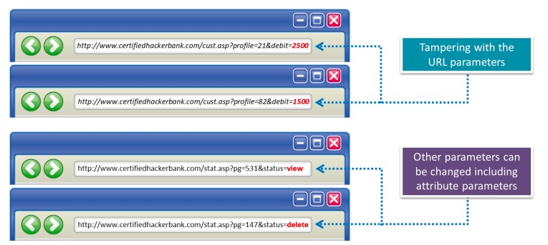
Parameter Tampering
Ethical Hacking and Countermeasures Copyright © by EC-Council. All Rights Reserved. Reproduction is Strictly Prohibited.

Slide 28
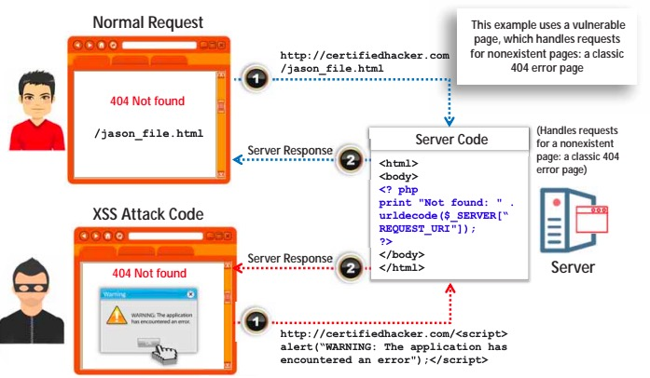
XSS Attack
Ethical Hacking and Countermeasures Copyright © by EC-Council. All Rights Reserved. Reproduction is Strictly Prohibited.
Notes:
k to the malicious script and sends it to the victim, luring the victim into clicking the link containing the malicious script/query. For example, if the attacker finds a cross-site scripting vulnerability on the bank.com website, he/she constructs a link embedded with a malicious script such as
<AHREF=http://bank.com/registration.cgi?clientprofile=<SCRIPT>maliciouscode</ SCRIPT>>Click here</A>
and sends an email to the target user. When the user clicks the link, the URL is sent to bank.com with the malicious code. The legitimate server hosting the bank.com website sends a page back to the user including the value of clientprofile, and the malicious code is executed on the client machine.

Slide 29
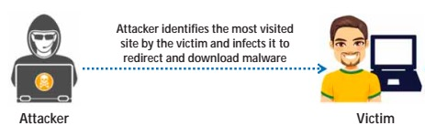
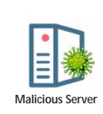

Watering Hole Attack
Ethical Hacking and Countermeasures Copyright © by EC-Council. All Rights Reserved. Reproduction is Strictly Prohibited.
Notes:
k to the malicious script and sends it to the victim, luring the victim into clicking the link containing the malicious script/query. For example, if the attacker finds a cross-site scripting vulnerability on the bank.com website, he/she constructs a link embedded with a malicious script such as
<AHREF=http://bank.com/registration.cgi?clientprofile=<SCRIPT>maliciouscode</ SCRIPT>>Click here</A>
and sends an email to the target user. When the user clicks the link, the URL is sent to bank.com with the malicious code. The legitimate server hosting the bank.com website sends a page back to the user including the value of clientprofile, and the malicious code is executed on the client machine.

Slide 30
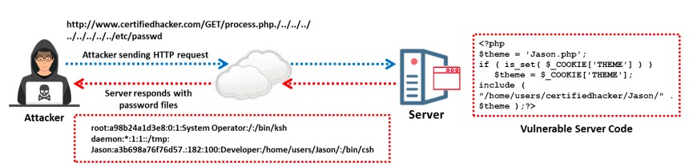
Directory Traversal Attack
Ethical Hacking and Countermeasures Copyright © by EC-Council. All Rights Reserved. Reproduction is Strictly Prohibited.
Notes:
When access is provided outside a defined application, there exists the possibility of unintended information disclosure or modification. Complex applications are configured with multiple directories that exist as application components and data. An application can traverse these directories to locate and execute the legitimate portions of an application. A directory traversal/forceful browsing attack occurs when the attacker is able to browse the directories and files outside the normal application access.

Slide 31
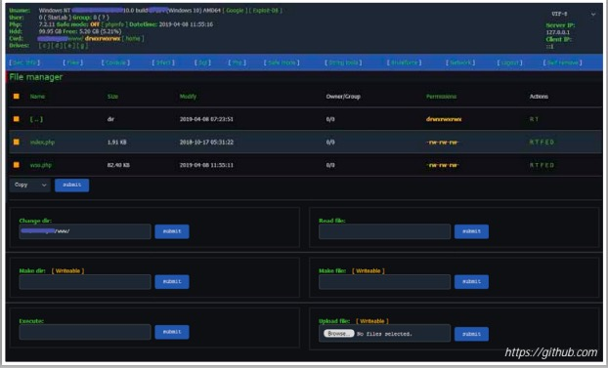
Web Shells
Mailcious piece of code or script
Written in server-side languages (PHP, ASP, PERL, RUBY, Python)
Installed on a target server
Common Tools
WSO Php Webshell (https://github.com)
b374k (https://github.com)
C99 (https://github.com)
China Chopper (https://www.fireeye.com)
R57 (https://github.com)
Pouya ASP Web Shell (https://github.com)
Weevely (https://github.com)
Ethical Hacking and Countermeasures Copyright © by EC-Council. All Rights Reserved. Reproduction is Strictly Prohibited.
Notes:
Directory traversal allows attackers to access restricted directories, including application source code, configuration, and critical system files, and execute commands outside the web server's root directory.

Slide 32
CEHv13 Update – Advanced Web App Attack Vectors
CEHv13 expands on modern attack types, including:
  API-specific vulnerabilities (e.g., broken object-level authorization, injection into REST/GraphQL)
  AI-generated fuzzing for input validation bypass
  Increased use of client-side attacks: CSRF, clickjacking, JavaScript injection, and DNS rebinding
Emphasis on hybrid threats like:
  Watering hole attacks combined with credential harvesting
  Session poisoning across federated login services
Tools now include automated scanners like OWASP ZAP with ML-based plugin extensions

Slide 33
CEHv13 Update – Web App Defense & DevSecOps Integration
CEHv13 promotes shifting security left with:
  Integration of dynamic application security testing (DAST) into CI/CD pipelines
  Use of secure coding guidelines (e.g., OWASP ASVS)
Enhanced defense recommendations:
  Implement rate limiting and input filtering at API gateways
  Use token validation, rotating secrets, and API inventory management
CEHv13 stresses aligning web application defense with OWASP Top 10 and NIST SSDF (Secure Software Development Framework)

